Slide 1
Nuclear structure around ⁶⁸Ni
J. Van de Walle, N. Kalantar et al.
KVI Groningen
⁶⁸Zn
⁶⁹Zn
⁷⁰Zn
⁷¹Zn
⁷²Zn
⁶⁷Cu
⁶⁸Cu
⁶⁹Cu
⁷⁰Cu
⁷¹Cu
⁶⁶Ni
⁶⁷Ni
⁶⁸Ni
⁶⁹Ni
⁷⁰Ni
⁶⁵Co
⁶⁶Co
⁶⁷Co
⁶⁸Co
⁶⁹Co
⁶⁴Fe
⁶⁵Fe
⁶⁶Fe
⁶⁷Fe
⁶⁸Fe
Some ideas inspired by :
Cu isotopes – collective and single particle properties (Leuven group)
The excursion to a “new island of inversion” south of ⁶⁸Ni
The fact that spectroscopy of n-rich Fe, Co isotopes at ISOL facilities is difficult !
Recent results from Mn and Fe β-decay at ISOLDE & LISOL
Boundary conditions :
1/ Complementarity
2/ Feasibility
3/ Uniqueness

Slide 2
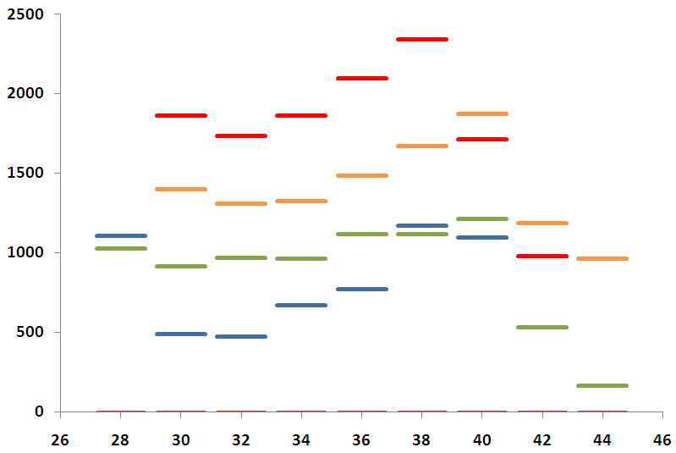
⁶⁸Zn
⁶⁹Zn
⁷⁰Zn
⁷¹Zn
⁷²Zn
Case 1 : ⁷⁵Cu
⁶⁷Cu
⁶⁸Cu
⁶⁹Cu
⁷⁰Cu
⁷¹Cu
⁷²Cu
⁷³Cu
⁷⁴Cu
⁷⁵Cu
⁶⁶Ni
⁶⁷Ni
⁶⁸Ni
⁶⁹Ni
⁷⁰Ni
Monopole migration of single particle levels
7/2-
7/2-
5/2-
3/2-
1/2-

Slide 3
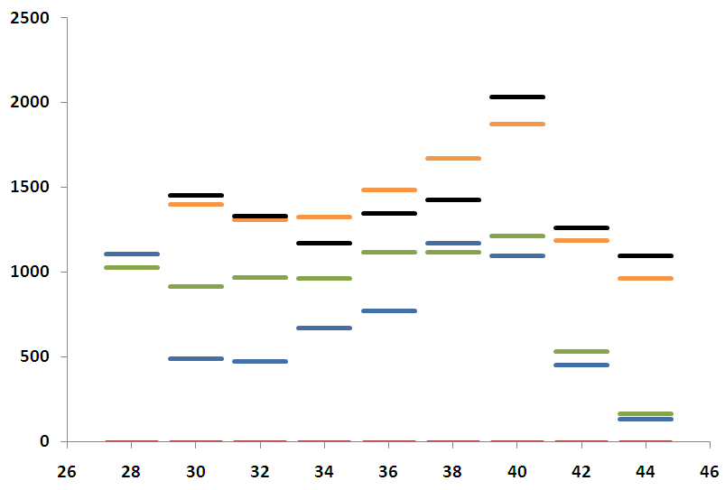
⁶⁸Zn
⁶⁹Zn
⁷⁰Zn
⁷¹Zn
⁷²Zn
Case 1 : ⁷⁵Cu
⁶⁷Cu
⁶⁸Cu
⁶⁹Cu
⁷⁰Cu
⁷¹Cu
⁷²Cu
⁷³Cu
⁷⁴Cu
⁷⁵Cu
⁶⁶Ni
⁶⁷Ni
⁶⁸Ni
⁶⁹Ni
⁷⁰Ni
Monopole migration of single particle levels
Particle-core coupled model
Nickel 2+ ⊗ 3/2- = 1/2- ,3/2-,5/2-, 7/2-
“weak coupling model”
Nickel J_{i}=2+
7/2-
5/2-
3/2-
1/2-

Slide 4
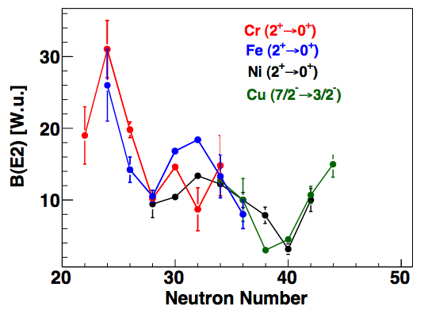
⁶⁸Zn
⁶⁹Zn
⁷⁰Zn
⁷¹Zn
⁷²Zn
Case 1 : ⁷⁵Cu
⁶⁷Cu
⁶⁸Cu
⁶⁹Cu
⁷⁰Cu
⁷¹Cu
⁷²Cu
⁷³Cu
⁷⁴Cu
⁷⁵Cu
⁶⁶Ni
⁶⁷Ni
⁶⁸Ni
⁶⁹Ni
⁷⁰Ni
Monopole migration of single particle levels
Particle-core coupled model
Nickel 2+ ⊗ 3/2- = 1/2- ,3/2-,5/2-, 7/2-
“weak coupling model”
Nickel J_{i}=2+
7/2-
5/2-
3/2-
1/2-

Slide 5
⁶⁸Zn
⁶⁹Zn
⁷⁰Zn
⁷¹Zn
⁷²Zn
⁷⁶Zn
Case 1 : ⁷⁵Cu
⁶⁷Cu
⁶⁸Cu
⁶⁹Cu
⁷⁰Cu
⁷¹Cu
⁷²Cu
⁷³Cu
⁷⁴Cu
⁷⁵Cu
⁶⁶Ni
⁶⁷Ni
⁶⁸Ni
⁶⁹Ni
⁷⁰Ni
⁷⁴Ni
Monopole migration of single particle levels
Particle-core coupled model
CONCLUSION :
➔ Intermediate energy coulex of ⁷⁴Ni and/or ⁷⁵Cu ?
➔ Plunger with proton knock-out from ⁷⁶Zn instead of ⁷⁵Cu ?
Nickel 2+ ⊗ 3/2- = 1/2- ,3/2-,5/2-, 7/2-
“weak coupling model”
Nickel J_{i}=2+
7/2-
5/2-
3/2-
1/2-

Slide 6
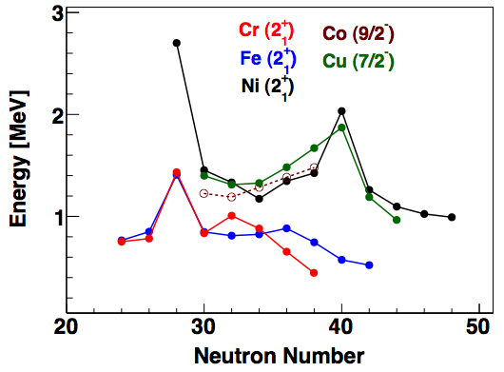
Case 2 : ^{67,68,69}Co
⁶⁸Zn
⁶⁹Zn
⁷⁰Zn
⁷¹Zn
⁷²Zn
⁶⁷Cu
⁶⁸Cu
⁶⁹Cu
⁷⁰Cu
⁷¹Cu
⁶⁶Ni
⁶⁷Ni
⁶⁸Ni
⁶⁹Ni
⁷⁰Ni
⁶⁵Co
⁶⁶Co
⁶⁷Co
⁶⁸Co
⁶⁹Co
⁶⁴Fe
⁶⁵Fe
⁶⁶Fe
⁶⁷Fe
⁶⁸Fe
Why Cobalt ?
Bridges the gap between spherical Ni isotopes and deformed region south of ⁶⁸Ni
Structure is subtle mixture of single particle states, deformed states
“Challenge for Shell Model” : structure depends crucially on N=40 and Z=28 gaps !
Isomers are likely to occur … detectors around LYCCA ?
Spectroscopic information only up to ⁶⁷Co ! Even though not very exotic, they’re not known !
Complementary to available β-decay data on ⁶⁷Fe and ^{67,68}Mng^{67,68}Fe – unique for ⁶⁹Co
How ?
Very feasible – yields of ^{68,69,70}Ni are good (ex. ⁷⁰Ni ≈ 1000/s for ⁸⁶Kr fragmentation) !
Double fragmentation of the A ≥ 68 Ni isotopes (potentially with plunger ?)

Slide 7
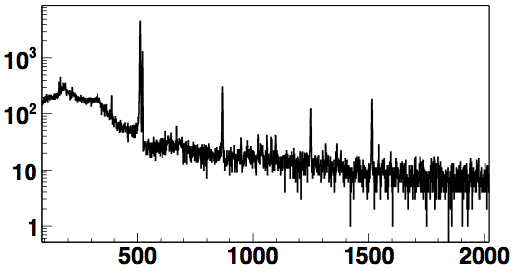
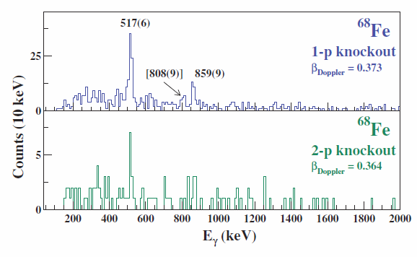
⁶⁸Zn
⁶⁹Zn
⁷⁰Zn
⁷¹Zn
⁷²Zn
Case 2 : ^{67,68,69}Co
⁶⁷Cu
⁶⁸Cu
⁶⁹Cu
⁷⁰Cu
⁷¹Cu
2009 : ⁶⁸Mn β-decay at ISOLDE
521
⁶⁶Ni
⁶⁷Ni
⁶⁸Ni
⁶⁹Ni
⁷⁰Ni
865
⁶⁸Fe
1250
1515
⁶⁵Co
⁶⁶Co
⁶⁷Co
⁶⁸Co
⁶⁹Co
⁶⁴Fe
⁶⁵Fe
⁶⁶Fe
⁶⁷Fe
⁶⁸Fe
Compare β-decay at ISOLDE and
double fragmentation at MSU …
Plunger not considered in LOI !
Fe lifetime measurements done at
Legnaro/GANIL/MSU already !
Co not ( … so far)
⁷⁶Ge beam at GSI ?
P. Adrich et al., PRC 77, 054306 (2008)
⁷⁶Ge @ 130 MeV.A
470 mg/cm² ⁹Be
⁶⁹Co + ⁷⁰Ni secondary beams on 188 mg/cm² ⁹Be
SEGA array (ε = 2%, FWHM ≈ 2-3% at 1 MeV)

